Slide 1
Introduction to PIG (DS3203)

Slide 2
Agenda
Learning Objectives | Learning Outcomes
Introduction to Pig To study the key features and anatomy of Pig. To study the execution modes of Pig. To study the various relational operators in pig. | To have an easy comprehension on when to use and when NOT to use Pig. To be able to differentiate between Pig and Hive.

Slide 3
Agenda
What is Pig?
Key Features of Pig
The Anatomy of Pig
Pig on Hadoop
Pig Philosophy
Pig Latin Overview
Pig Latin Statements
Pig Latin: Identifiers
Pig Latin: Comments
Data Types in Pig
Simple Data Types
Complex Data Types

Slide 4
Agenda
Running Pig
Execution Modes of Pig
Relational Operators
Eval Function
Piggy Bank
When to use Pig?
When NOT to use Pig?
Pig versus Hive

Slide 5
What is Pig?
Apache Pig is a platform for data analysis.
It is an alternative to Map Reduce Programming.
Pig was developed as a research project at Yahoo.

Slide 6
Features of Pig
It provides an engine for executing data flows (how your data should flow). Pig processes data in parallel on the Hadoop cluster.
It provides a language called “Pig Latin” to express data flows.
Pig Latin contains operators for many of the traditional data operations such as join, filter, sort, etc.
It allows users to develop their own functions (User Defined Functions) for reading, processing, and writing data.
Pig Latin is a high-level scripting language that hides the complexity of MapReduce. Under the hood, Pig Latin lines are turned into a set of MapReduce jobs. This lets data be processed quickly and in different places.

Slide 7
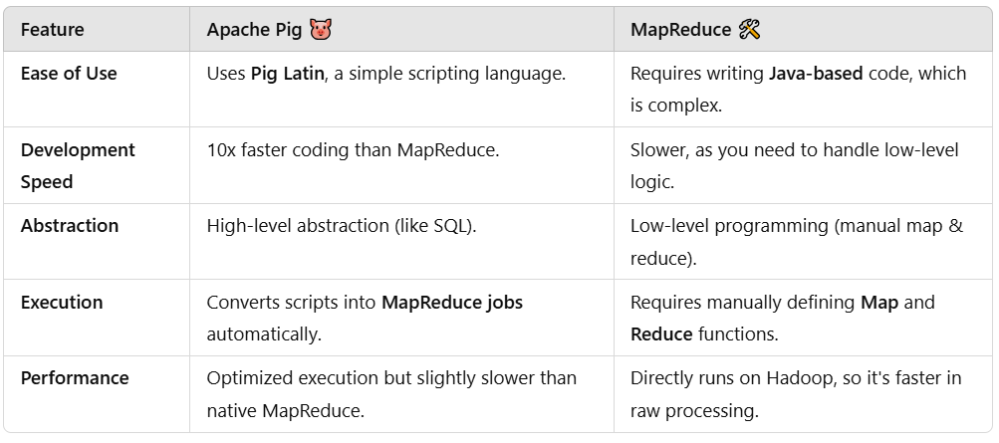
Apache Pig instead of MapReduce

Slide 8
When to use Pig instead of Mapreduce?
Need quick development with less code.
Want an SQL-like approach to process big data.
No need to write Java code.

Slide 9
When to use Mapreduce instead of Pig?
Need fine-tuned performance optimizations.
Task is very low-level and requires full control.
Working with a very large Hadoop cluster with complex requirements.

Slide 10
The Anatomy of Pig
The main components of Pig are as follows:
Data flow language (Pig Latin).
Interactive shell where you can type Pig Latin statements (Grunt).
Pig interpreter and execution engine.
Apache Pig converts pig Latin scripts into a series of MapReduce jobs. So, it makes it easy for programmers.

Slide 11
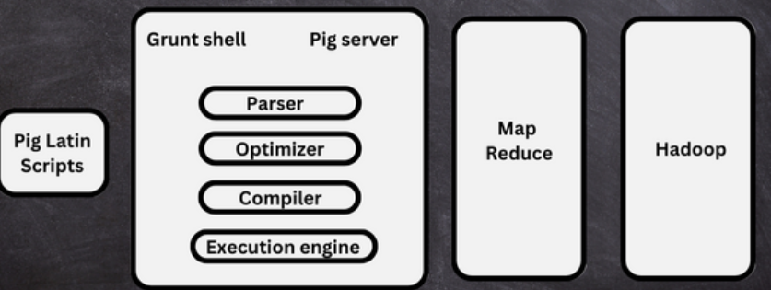
Apache Pig Architecture

Slide 12
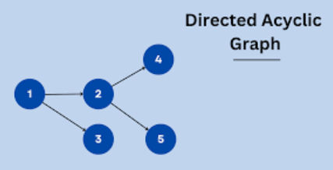
Apache Pig Architecture
Pig Latin Scripts - To perform particular operations using Apache Pig we need to write pig Latin script. These are executed either by Grunt shell for interactive execution or user defined functions in Java Programming Language.
Parser - Used to read pig latin script and analyze the syntax. The output is Directed Acyclic Graph (DAG) where the logical operators are nodes and data flow through them are edges.
Optimizer – Improves the logical statements for better speed.

Slide 13
Apache Pig Architecture
Compiler - Converts the optimized logical plan into executable instructions, which are then transformed into MapReduce jobs. It acts as a bridge between the logical plan and execution, ensuring efficient and accurate data processing on a distributed cluster.
Execution Engine - After successful compilation generated MapReduce jobs will execute in a sorted order in Apache Hadoop using the execution engine and generates the desired result. The generated output will get stored on hdfs (Hadoop distributed file system).

Slide 14
Pig on Hadoop
Pig runs on Hadoop.
Pig uses both Hadoop Distributed File System and MapReduce Programming.
By default, Pig reads input files from HDFS. Pig stores the intermediate data (data produced by MapReduce jobs) and the output in HDFS.
However, Pig can also read input from and place output to other sources.

Slide 15
Pig Philosophy
Pig Philosophy
Pigs Fly
Pigs Eat Anything
Pigs Live Anywhere
Pigs are Domestic Animals

Slide 16
Use Case for Pig
Pig is widely used for ETL (Extract, Transform and Load)
Pig can extract data from different sources such as ERP, Accounting, Flat Files, etc.
Pig uses operators to perform transformation on the data and subsequently loads it into the data warehouse.

Slide 17
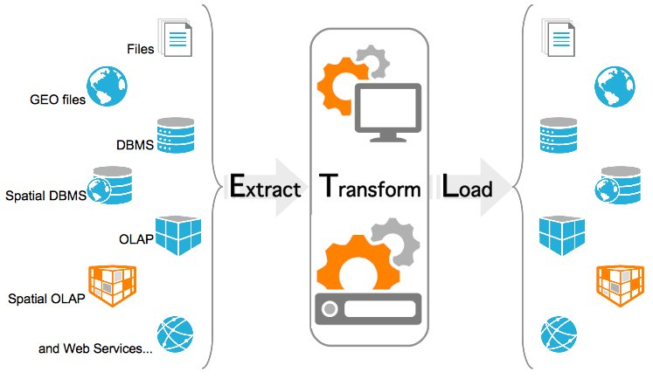

Slide 18
Pig Latin Overview: Statements
Pig Latin Statements are generally ordered as follows:
LOAD statement that reads data from the file system.
Series of statements to perform transformations.
DUMP or STORE to display/store result.
Here A is relation and NOT a variable
A = load 'student' (rollno, name, gpa);
A = filter A by gpa > 4.0;
A = foreach A generate UPPER (name);
STORE A INTO ‘myreport’

Slide 19
Pig Latin Overview: Comments
In Pig Latin two types of comments are supported:
Single line comments that begin with “--” (two hyphens).
Multiline comments that begin with “/* and end with */”.

Slide 20
Pig Latin Overview: Identifiers
Valid Identifiers
Y
A1
A1_2014
Sample

Slide 21
Pig Latin Overview: Operators
Arithmetic | Comparison | Null | Boolean
+ | = = | IS NULL | AND
- | ! = | IS NOT NULL | OR
* | < |  | NOT
/ | >
% | <=
 | >=

Slide 22
Data Types in PIG
Simple Data Types
Name | Description
int | Whole numbers
long | Large whole numbers
float | Decimals
double | Very precise decimals
chararray | Text strings
bytearray | Raw bytes
datetime | Datetime
boolean | true or false
Complex Data Types
Name | Description
Tuple | An ordered set of fields. Example: (2,3)
Bag | A collection of tuples. Example: {(2,3),(7,5)}
map | key, value pair (open # Apache)

Slide 23
Running Pig
Pig can run in two ways:
Interactive Mode
Invoke grunt Shell
Type pig to get grunt shell
A= load ‘/pigdemo/student.tsv’ as ( rollno, name, gpa );
DUMP A;
Batch Mode
Create Pig Script to run pig in batch mode
Write Pig Latin Statements in a file and save it “.pig” extension

Slide 24
Execution Modes of Pig
You can execute pig in two modes:
Local Mode
You need to have your files in local file system
Pig –x local filename
Map Reduce Mode (Default Mode)
You need to have access to a Hadoop Cluster to read/write file.
pig filename

Slide 25
Relational Operators
FILTER
FOREACH
GROUP
DISTINCT
LIMIT
ORDERBY
JOIN
UNION
SPLIT
SAMPLE

Slide 26
FILTER-BY
Find the tuples of those student where the GPA is greater than 4.0.
A = load '/pigdemo/student.tsv' as (rollno:int, name:chararray, gpa:float);
B = filter A by gpa > 4.0;
DUMP B;
Notes:
TSV is tab separated values. TSV files use tabs (\t) as delimiters, while CSV (Comma-Separated Values) files use commas (,).

Slide 27
FOREACH
Display the name of all students in uppercase.
A = load '/pigdemo/student.tsv' as (rollno:int, name:chararray, gpa:float);
B = foreach A generate UPPER (name);
DUMP B;
Notes:
FOREACH A iterates over each record in relation A.
DUMP B; displays the transformed output.

Slide 28
GROUP-BY
Group tuples of students based on their GPA.
A = load '/pigdemo/student.tsv' as (rollno:int, name:chararray, gpa:float);
B = GROUP A BY gpa;
DUMP B;

Slide 29
DISTINCT
To remove duplicate tuples of students.
A = load '/pigdemo/student.tsv' as (rollno:int, name:chararray, gpa:float);
B = DISTINCT A;
DUMP B;

Slide 30
JOIN-BY
To join two relations namely, “student” and “department” based on the values contained in the “rollno” column.
A = load '/pigdemo/student.tsv' as (rollno:int, name:chararray, gpa:float);
B = load '/pigdemo/department.tsv' as (rollno:int, deptno:int,deptname:chararray);
C = JOIN A BY rollno, B BY rollno;
DUMP C;
DUMP B;

Slide 31
SPLIT
To partition a relation based on the GPAs acquired by the students.
GPA = 4.0, place it into relation X.
GPA is < 4.0, place it into relation Y.
A = load '/pigdemo/student.tsv' as (rollno:int, name:chararray, gpa:float);
SPLIT A INTO X IF gpa==4.0, Y IF gpa<=4.0;
DUMP X;

Slide 32
Eval Functions
AVG
MAX
COUNT

Slide 33
AVG
To calculate the average marks for each student.
A = load '/pigdemo/student.csv' USING PigStorage (‘,’) as (studname:chararray,marks:int);
B = GROUP A BY studname;
C = FOREACH B GENERATE A.studname, AVG(A.marks);
DUMP C;
Notes:
Pig would require an explicit delimiter specification for .csv file.

Slide 34
MAX
To calculate the maximum marks for each student.
A = load '/pigdemo/student.csv' USING PigStorage (‘,’) as (studname:chararray, marks:int);
B = GROUP A BY studname;
C = FOREACH B GENERATE A.studname, MAX(A.marks);
DUMP C;

Slide 35
COUNT
To count the number of elements in a bag
A = load '/pigdemo/student.csv' USING PigStorage (‘,’) as (studname:chararray, marks:int);
B = GROUP A BY studname;
C = FOREACH B GENERATE A.studname, COUNT(A);
DUMP C;

Slide 36
COMPLEX DATA TYPES: TUPLE
TUPLE is an ordered collection of fields.
(John,12) (Jack,13)
(Joseph,5) (Smith,8)
(James, 7) (Scott,12)
A = LOAD '/root/pigdemos/studentdata.tsv' AS ( t1:tuple (t1a:chararray, t1b:int ), t2:tuple ( t2a:chararray, t2b:int ) ;
B = FOREACH A GENERATE t1.t1a,t1.t1b,t2$0,t2$1;
DUMP B
Notes:
Each row consists of two tuples, each containing a name (chararray) and a number (int).
The first tuple is (t1a, t1b)
The second tuple is (t2a, t2b)

Slide 37
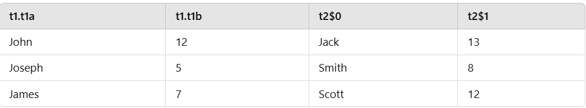
OUTPUT: TUPLE
t1.t1a → The first element (chararray) of the first tuple.
t1.t1b → The second element (int) of the first tuple.
t2$0 → The first element of the second tuple (equivalent to t2.t2a).
t2$1 → The second element of the second tuple (equivalent to t2.t2b).
Notes:
Each row consists of two tuples, each containing a name (chararray) and a number (int).
The first tuple is (t1a, t1b)
The second tuple is (t2a, t2b)

Slide 38
COMPLEX DATA TYPES: MAP
MAP represents a key/value pair.
John [city#Bangalore]
Jack [city#Pune]
James [city#Chennai]
A = load '/root/pigdemos/studentcity.tsv' Using PigStorage as (studname:chararray,m:map[chararray]);
B = foreach A generate m#'city' as CityName:chararray;
DUMP B
Notes:
studname: Represents the student's name (type: chararray)
m: Represents a map where:
The keys are of type chararray.
The values are of type chararray.

Slide 39
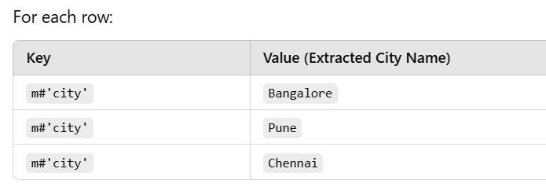
OUTPUT: MAP

Slide 40
PIGGY BANK
Pig user can use Piggy Bank function in Pig Latin script and they can also share their fuctions in Piggy Bank.upper function.
Objective: To use Piggy Bank string UPPER function.
register '/root/pigdemos/piggybank-0.12.0.jar';
A = load '/pigdemo/student.tsv' as (rollno:int, name:chararray, gpa:float);
upper = foreach A generate
org.apache.pig.piggybank.evaluation.string.UPPER(name);
DUMP upper;

Slide 41
USER-DEFINED FUNCTIONS (UDF)
Pig allows you to create your own function for complex analysis.
Write a java class and convert it into “.jar” to include this function into code.
register '/root/pigdemos/myudfs.jar';
A = load '/pigdemo/student.tsv' as (rollno:int, name:chararray, gpa:float);
upper = foreach A generate myudfs.UPPER(name);
DUMP B;

Slide 42
PARAMETER SUBSTITUTION
Pig allows you to pass parameters at runtime.
To execute the statement type below command on grunt:
Pig –param student=/pigdemo/student.tsv parameterdemo.pig
A = load ‘$student' as (rollno:int, name:chararray, gpa:float);
DUMP A;
Notes:
Here, $student will be replaced with /pigdemo/student.tsv.
DUMP A will print all records from /pigdemo/student.tsv.

Slide 43
DIAGNOSTIC OPERATOR
DESCRIBE : It returns the schema of a relation
A = load ‘/pigdemo/student.tsv' as (rollno:int, name:chararray, gpa:float);
DESCRIBE A;

Slide 44
WORD COUNT EXAMPLE IN PIG
lines=LOAD ‘/root/pigdemo/lines.txt’ AS (line:chararray);
words=FOREACH lines GENERATE FLATTEN ( TOKENIZE (line)) as word;
grouped=GROUP words by word;
wordcount = FOREACH grouped GENERATE group, COUNT (words);
DUMP wordcount;
TOKENIZE splits the line into a field for each word.
FLATTEN will take the collection of records returned by TOKENIZE and produce a separate record for each one, calling the single field in the record word.

Slide 45
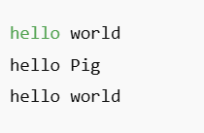
1. Load the file
Suppose the contents of lines.txt is as shown.
lines = LOAD ‘/root/pigdemo/lines.txt’ AS (line:chararray); loads the text file.
Each line is stored as a single chararray.

Slide 46
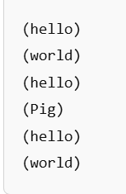
2. Tokenize each line into words
TOKENIZE(line): Splits each line into separate words.
words = FOREACH lines GENERATE FLATTEN(TOKENIZE(line)) as word;
FLATTEN: Converts the list of words into individual records.
Example after tokenization :

Slide 47
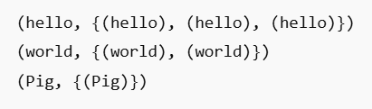
3. Group by word
Groups the words together so that the same words are in a single group.
grouped = GROUP words BY word;
Example output :

Slide 48
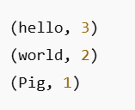
4. Count the Occurrences of Each Word
wordcount = FOREACH grouped GENERATE group, COUNT(words);
group refers to the word.
COUNT(words) counts the occurrences of that word.
Example output :

Slide 49
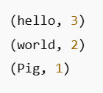
5. Display the Final Word Count
DUMP wordcount;
Prints the word count for each word in the dataset.
Final output :

Slide 50
When to use Pig?
Pig can be used in the following situations:
When data loads are time sensitive.
When processing various data sources.
When analytical insights are required through sampling.

Slide 51
When NOT to use Pig?
Pig should not be used in the following situations:
When data is completely unstructured such as video, text, and audio.
When there is a time constraint because Pig is slower than MapReduce jobs.

Slide 52
PIG at YAHOO
Yahoo uses PIG for two things:
In Pipelines, to fetch log data from its web servers and to perform cleansing to remove companies interval views and clicks.
In Research, script is used to test a theory. Pig provides facility to integrate Perl or Python script which can be executed on a huge dataset.

Slide 53
Pig Vs. Hive
Features | Pig | Hive
Used By | Programmers and Researchers | Analyst
Used For | Programming | Reporting
Language | Procedural data flow language | SQL Like
Suitable For | Semi - Structured | Structured
Schema / Types | Explicit | Implicit
UDF Support | YES | YES
Join / Order / Sort | YES | YES
DFS Direct Access | YES (Implicit) | YES (Explicit)
Web Interface | YES | NO
Partitions | YES | No
Shell | YES | YES

Slide 54
Fill in the blanks
Pig is a ___________ language.
In Pig, ___________ is used to specify data flow.
Pig provides an ___________ to execute data flow.
___________, ___________ are execution modes of Pig.
Pig is used in ___________ process.

Slide 55
Answers
Scripting
Pig Latin
Pig Engine
Local Mode, MapReduce Mode
Grunt

